Slide 1






VS Code Dev Days
São Paulo
Sábado, 06/09/2025
UniFECAF – Taboão da Serra-SP

Slide 2



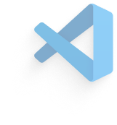




VS Code Dev Days
VS Code:
O Editor de Código de IA Open Source
Técnicas Essenciais para GitHub Copilot no VS Code

Slide 3
01
02
03
04
Introdução ao VS Code
Open source AI Editor
Últimos Recursos em IA
Q&A
Notes:
Today we're going to start with giving a brief introduction to VS code if you are brand new to VS code And after that we're going to take a look at some of the new API editor features that are really turning Visual Studio code into an agentic code editor We're going to take a look at a bunch of these things in action and then give you an overview of all these new features that you can take advantage of today Then finally we'll have a little bit of time for Q&A

Slide 4



Família Visual Studio
GitHub
+50 milhões de Devs ativos mensalmente
150 milhões de Devs ao redor do mundo
Notes:
one of the things to note is the rapid growth that Visual Studio and Visual Studio code have had with now over 50 million active developers And on top of that there are now over 150 million developers using GitHub and over 20 million developers using GitHub copilot.

Slide 5
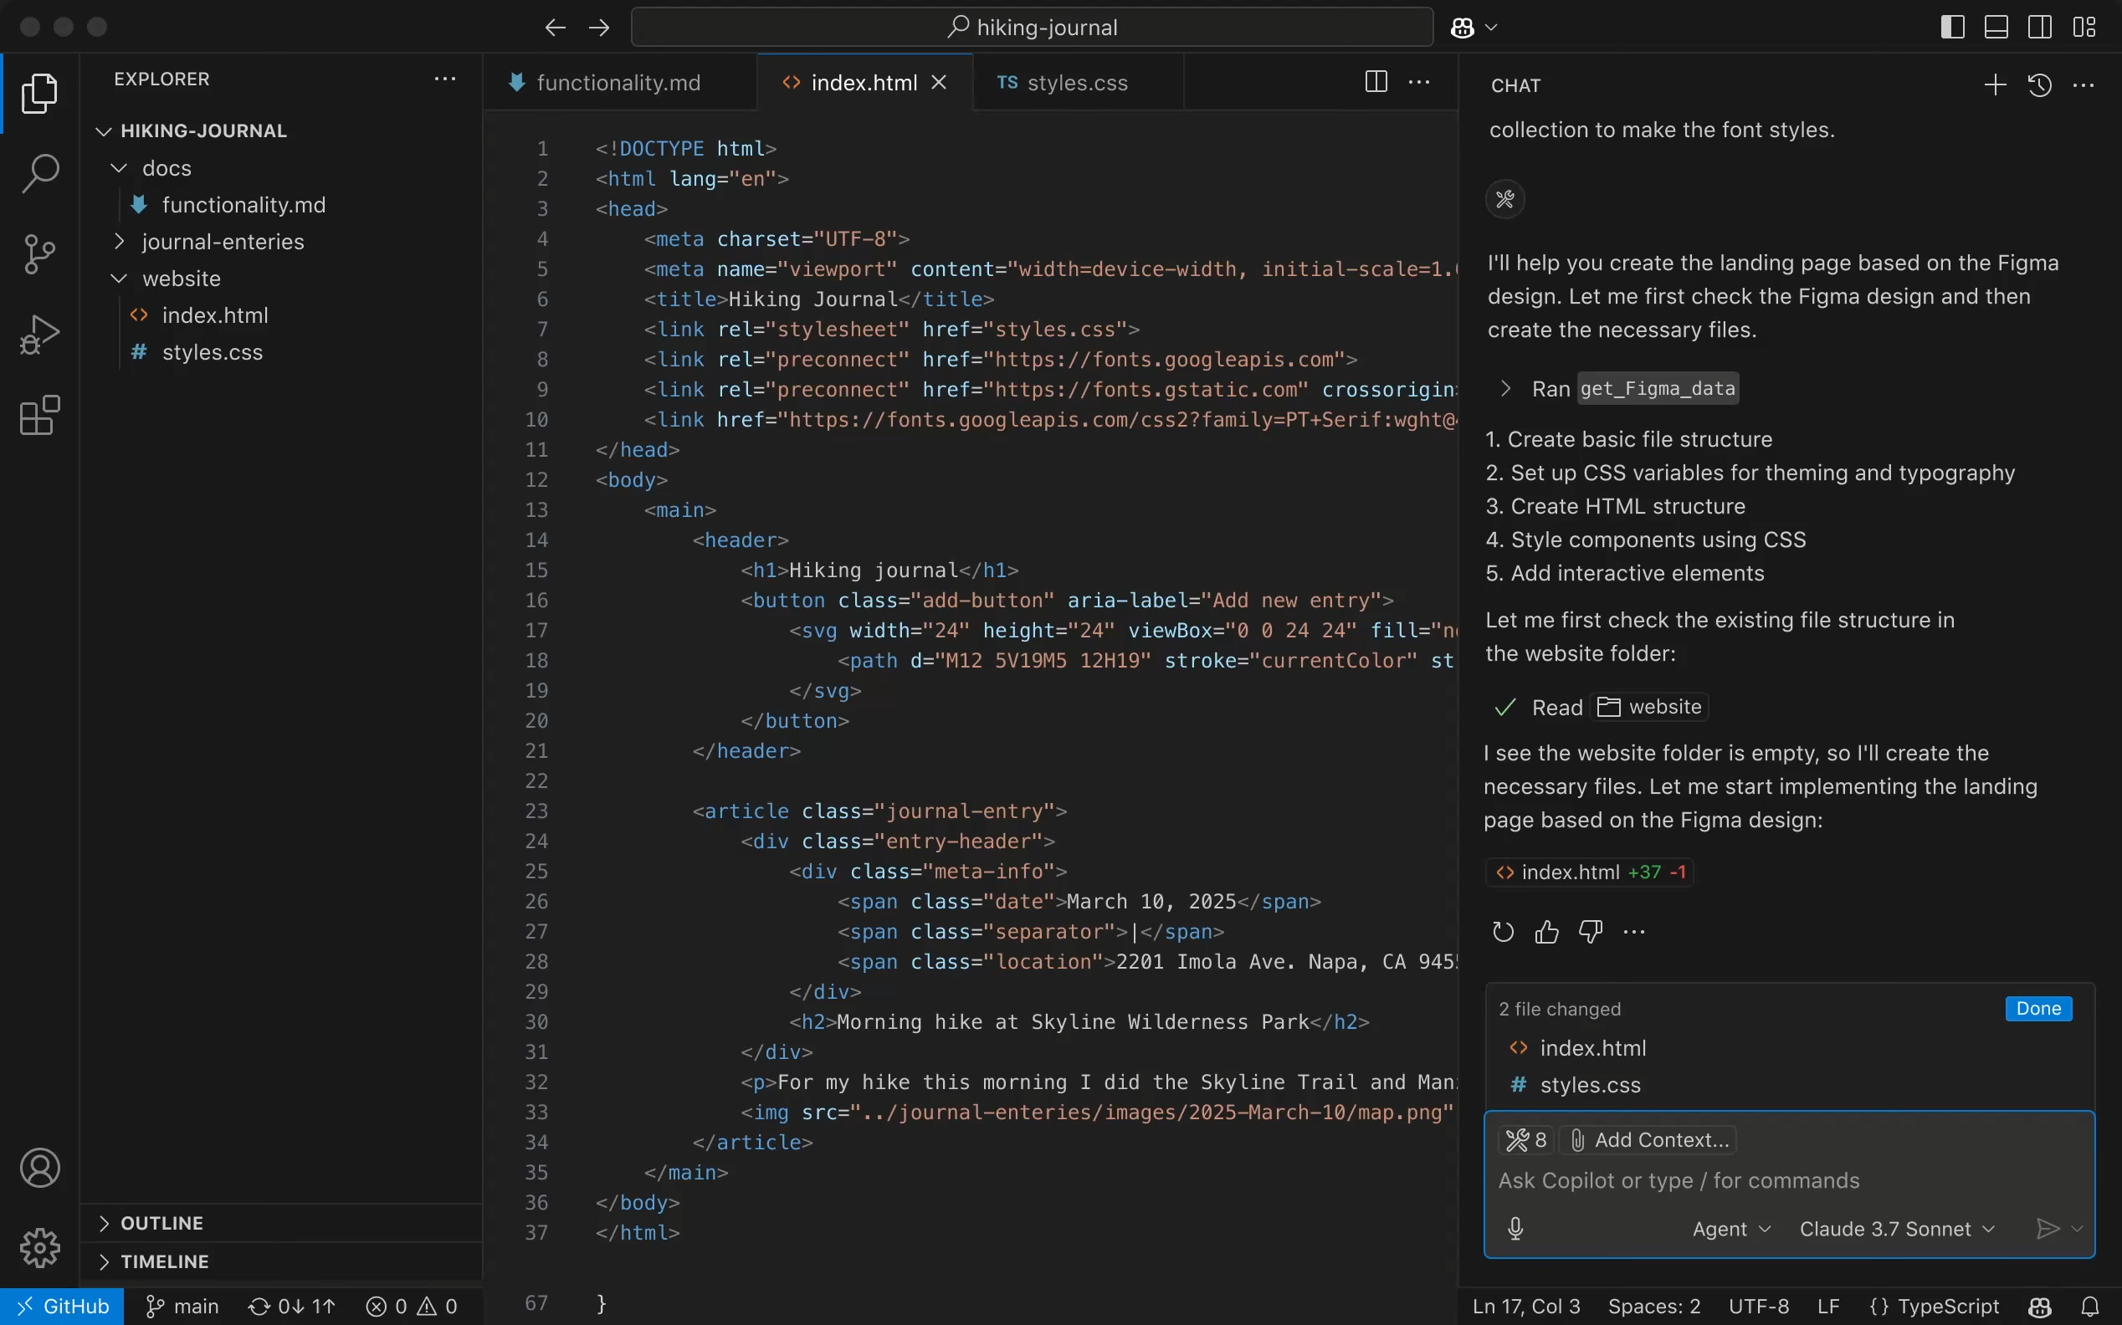
Notes:
And today's Visual Studio Code is completely different than when it first started over 10 years ago as a fully open source code editor
There's a vast ecosystem of extensions and builders creating new things every day for it and over the past several years Visual Studio Code has been transformed with agentic development leveraging GitHub copilot.
It is an open source AI editor and has open source AI integrations built in it means that developers can build on top of that as well for their own AI integrations.

Slide 6
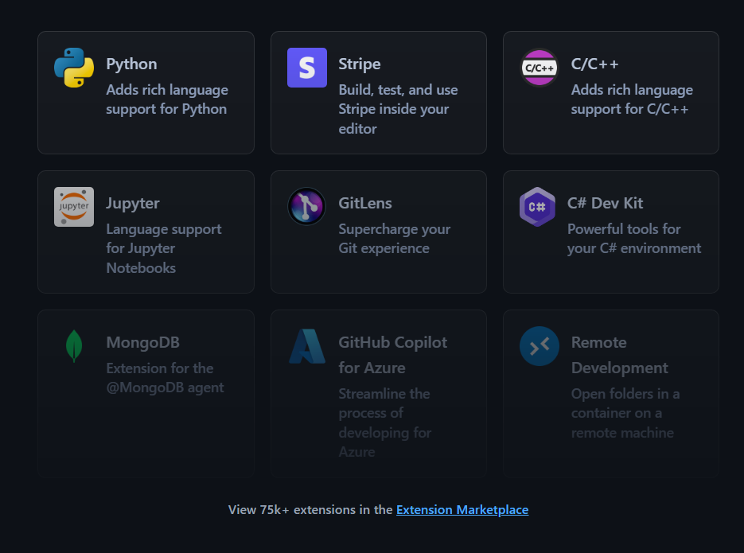
Codifique com extensões
Personalize o VS Code com extensões que disponibilizam funcionalidades alimentadas por IA de extensões, além de MCP Servers (integrações baseadas em Model Context Protocol) para uso no Chat. Ou, construa sua propria extensão para empoderar seu time em cenários únicos.
Notes:
let's start at the beginning Visual Studio code is an ecosystem of amazing extensions that are built on top of the core open source vscode project
This means you can use the source control you want the programming languages the debuggers that you want databases that you want and anything in between

Slide 7
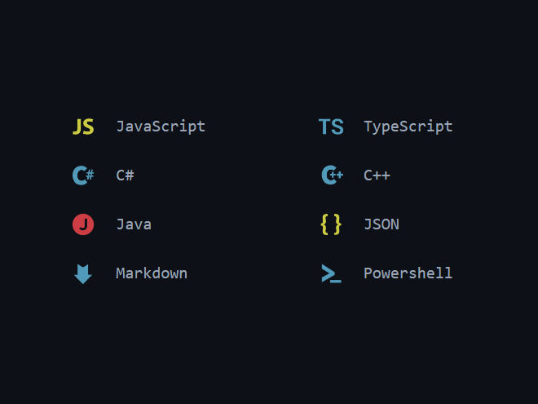
Codifique em qualquer linguagem
O VS Code suporta a maioria das linguagens de programação. Várias já vêm incluídas, como JavaScript, TypeScript, CSS e HTML, mas extensões para outras podem ser encontradas no VS Code Marketplace.
Notes:
and because of these ecosystem and extensions it means that you can program and basically every single programming language out there and it's not just programming language it's other things like being able to modify and edit JSON or markdown for example

Slide 8
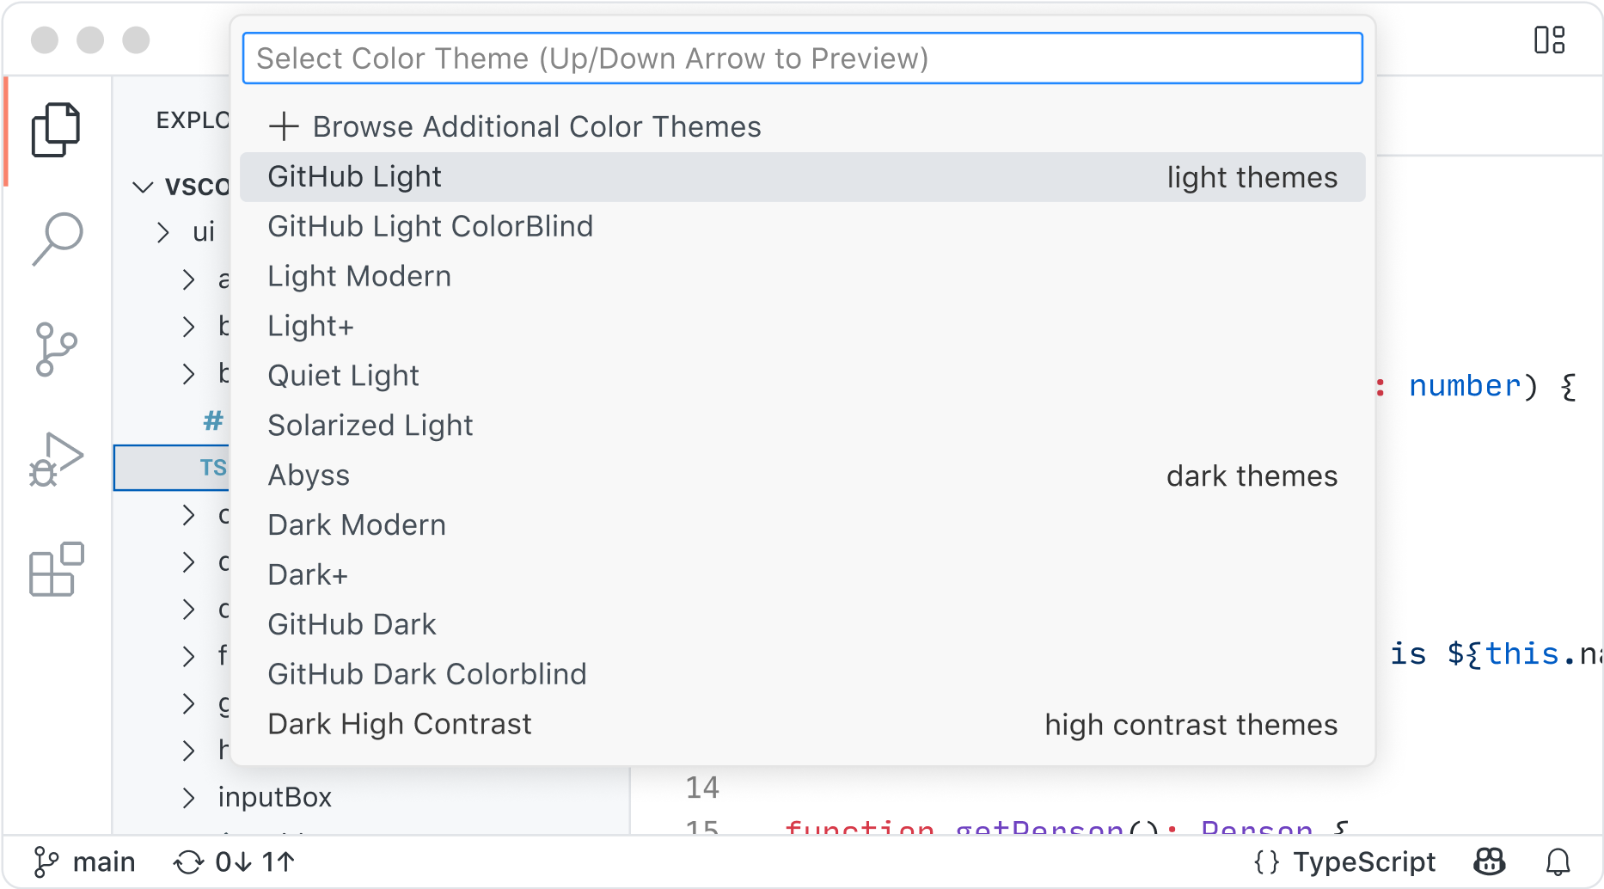
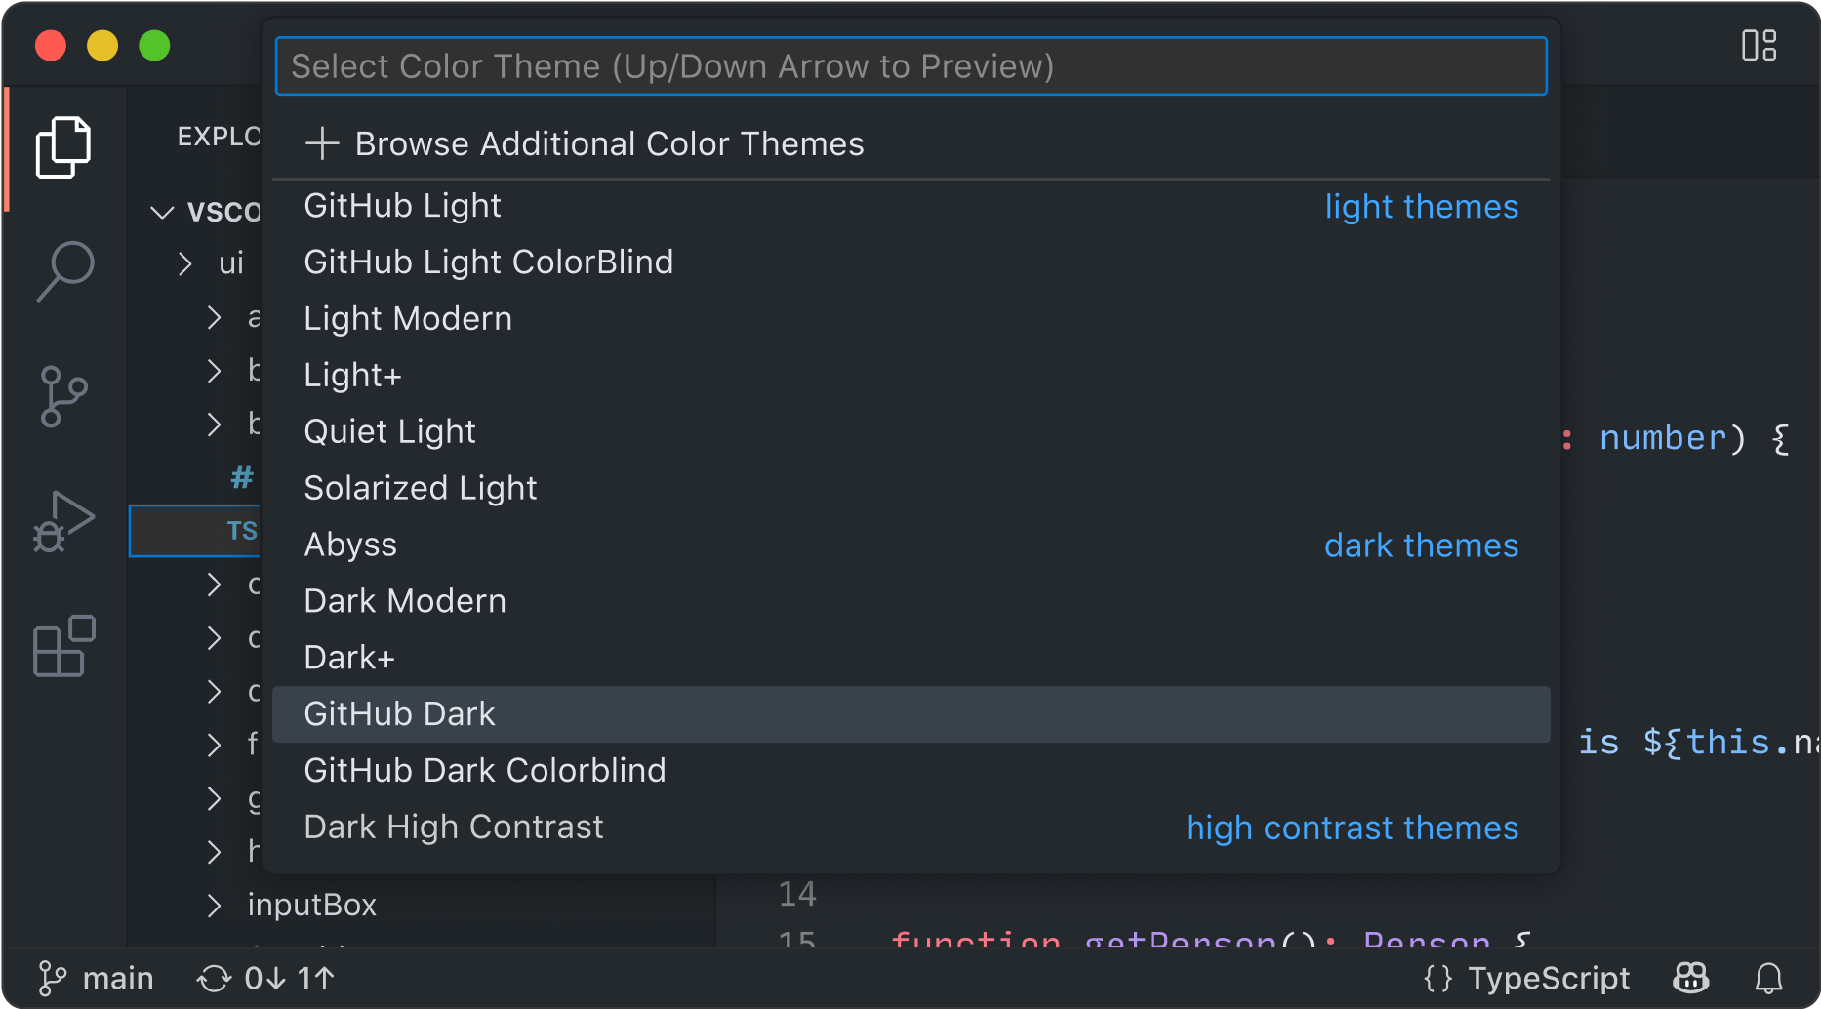
Totalmente personalizável
Personalize a interface e o layout do VS Code para que eles se adaptem ao seu estilo de codificação.
Color themes permite que você modifique as cores na interface do VS Code para atender às suas preferências e ambiente de trabalho.
Settings Sync permite que você compartilhe suas configurações de usuário em suas instâncias do VS Code com um mecanismo de sincronização..
Profiles permitem que você crie conjuntos de personalizações e alterne rapidamente entre elas ou compartilhe as mesmas com outras pessoas.
Notes:
Visual Studio Code is a fully customizable with tons of custom themes the ones that you can create yourself you can easily synchronize settings between your different development machines and you can even create profiles which are really powerful ways of saying I want to Python profile or a C# profile that enables you to enable or disable different extensions and customizations to your liking

Slide 9
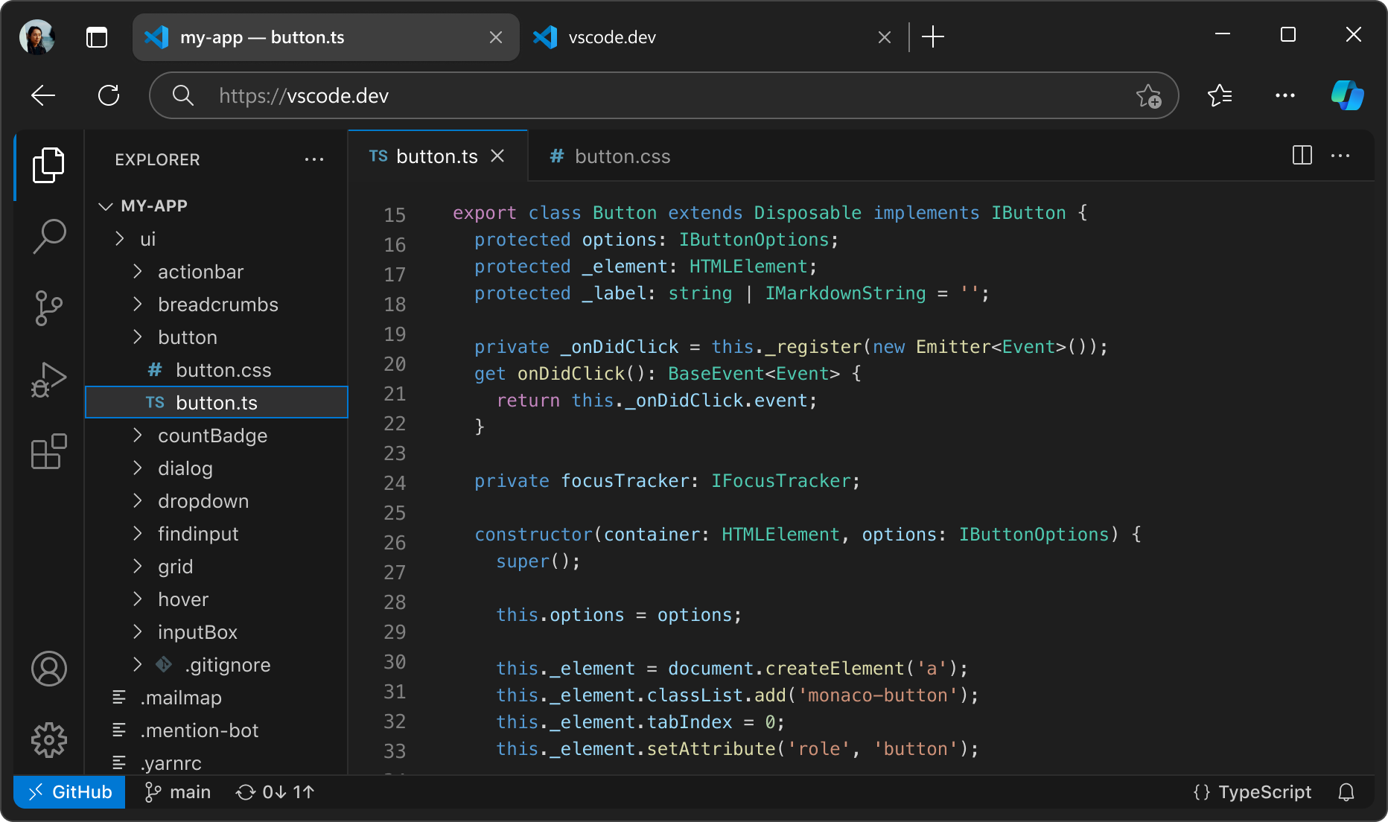
Codifique em qualquer lugar
Codifique onde você for mais produtivo, esteja você conectado à nuvem, a um repositório remoto ou no navegador com o VS Code for the Web (vscode.dev).
Built-in Source Control oferece suporte para Git out-of-the-box (já pronto para uso). As integrações com outras ferramentas de gerenciamento de código estão disponíveis por meio de extensões.
GitHub Codespaces fornece ambientes de desenvolvimento baseados em nuvem para qualquer atividade, seja um projeto de longo prazo ou uma tarefa de curto prazo - como revisar um pull request.
Notes:
the Visual Studio code isn't just on your computer it's also in the cloud you can leverage VS code on vscode dot dev or any GitHub codespace with cloud powered development environments that you can use from any machine even an iPad

Slide 10
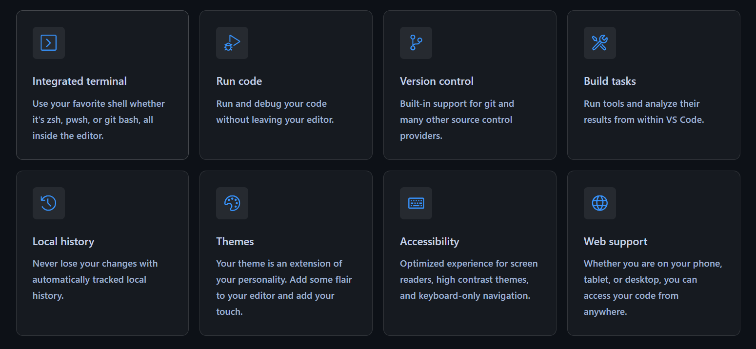
Codifique com recursos avançados
Há muito mais do que funcionalidades de edição. Seja com recursos integrados ou extensões avançadas, há recursos úteis para todos.
Notes:
And there's tons of rich features that have been developed over the years including integrated terminal support version control local history when you're modifying files and of course it is one of the most accessible code editors in the world.

Slide 11

Notes:
Now as I mentioned Visual Studio code has completely transformed into an open source AI first code editor. Not only is Visual Studio code itself open source but so are the GitHub copilot chat integrations inside of VS code

Slide 12
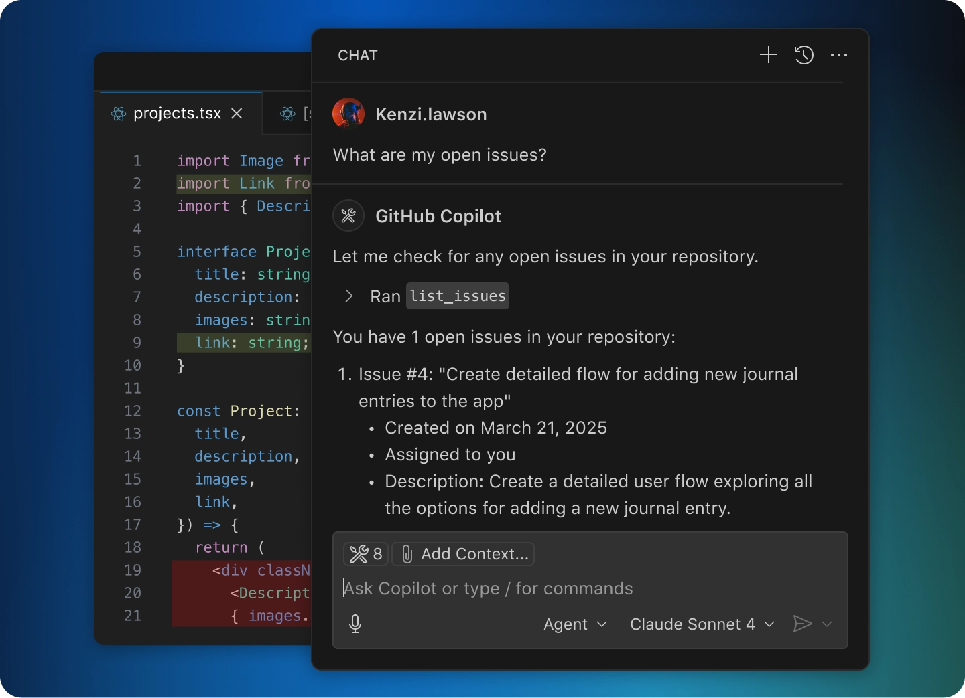
Agent Mode
Lide com tarefas complexas e com várias etapas. O Agent mode lê seu código-fonte, sugere edições em arquivos, executa comandos de terminal e responde a falhas de compilação ou teste — tudo em um loop até que a tarefa seja concluída. Refine ainda mais o Agent mode para se adequar aos fluxos de trabalho da sua equipe com extensões do VS Code e MCP Servers (integrações baseadas em Model Context Protocol).
Notes:
when we think of AI we often think of code completions when we're typing code but really agent mode has transformed how developers are building applications today at a rapid pace. You can provide a context give it powerful tools to run commands in the terminal or speak directly to GitHub and it can understand your entire code base to complete tasks and implement rich functionality

Slide 13
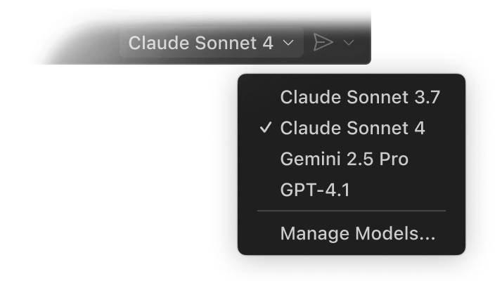
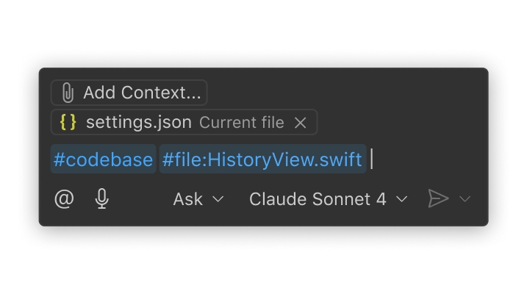
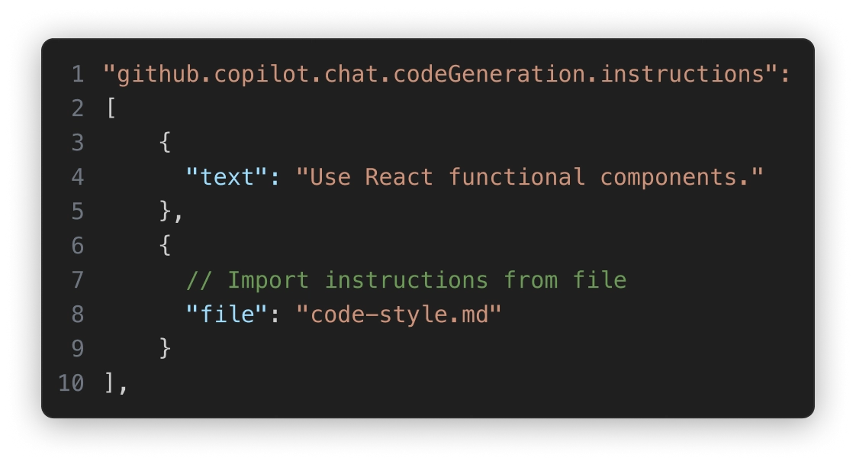
Um especialista em seu código-fonte
Qualquer modelo para qualquer equipe
Uma IA que trabalha do jeito que você faz
Use modelos de IA out of the box (prontos para uso) como o Claude Sonnet, ou traga sua própria chave para acessar modelos da Azure, Anthropic, Google, Ollama, OpenAI e OpenRouter.
Seu código-fonte está indexado localmente e remotamente (no GitHub) para entender o que é relevante, permitindo interações rápidas e com consciência do contexto.
Personalize as interações usando instruções customizadas e arquivos de prompt reutilizáveis ​​adaptados aos seus fluxos de trabalho, ferramentas e projetos.
Notes:
with GitHub copilot you get access to several models directly out-of-the-box or you can even bring your own API key to configure your own custom models that you want to use including ones that are running on your device with ollama for example
I mentioned that you can provide context, so you can reference files code bases you can even specifically reference HTML in the Dom for example
and then everything is highly customizable from exactly how you want the code to be generated and with your styles or to how you want a commit message to be generated with emojis for example everything is customizable directly to your liking for you and your team period

Slide 14
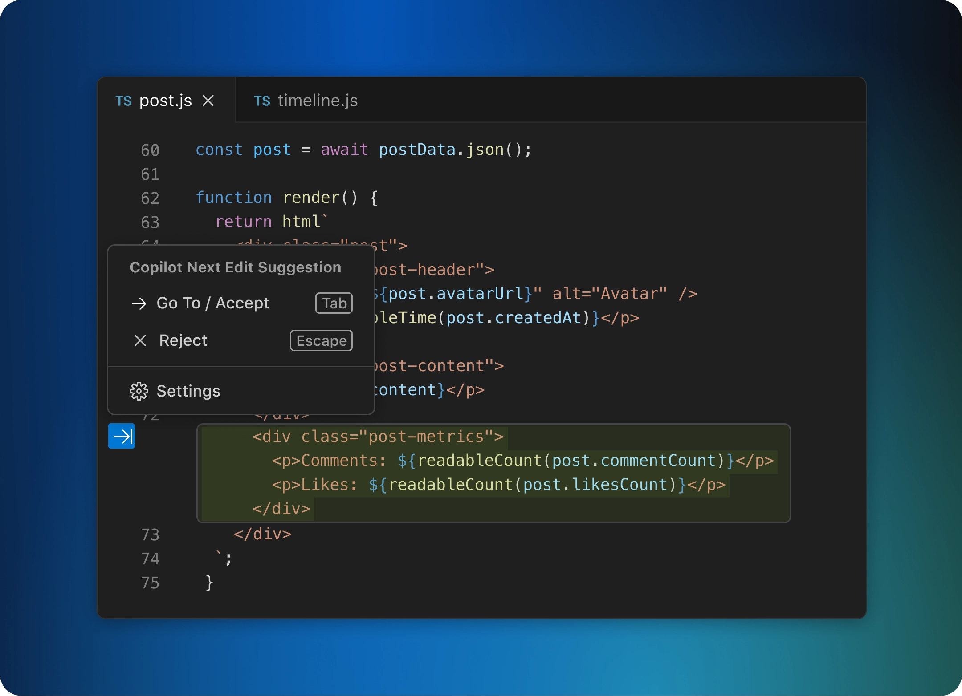
Next edit suggestions
O VS Code prevê seu próximo passo enquanto você codifica. Use a tecla Tab para aceitar sugestões de IA diretamente no seu editor. Ele recomenda de forma inteligente o que alterar — e onde — com base nas edições que você já está fazendo.
Notes:
Now code completions when you're typing code are an essential part to Visual Studio code being an AI code editor.
vscode goes a step further enabling predictions across code files based on the edits that you've already made. Change the name of a property it'll suggest automatically all of the other changes that need to be made in that file and you can tab tab tab to completion

Slide 15

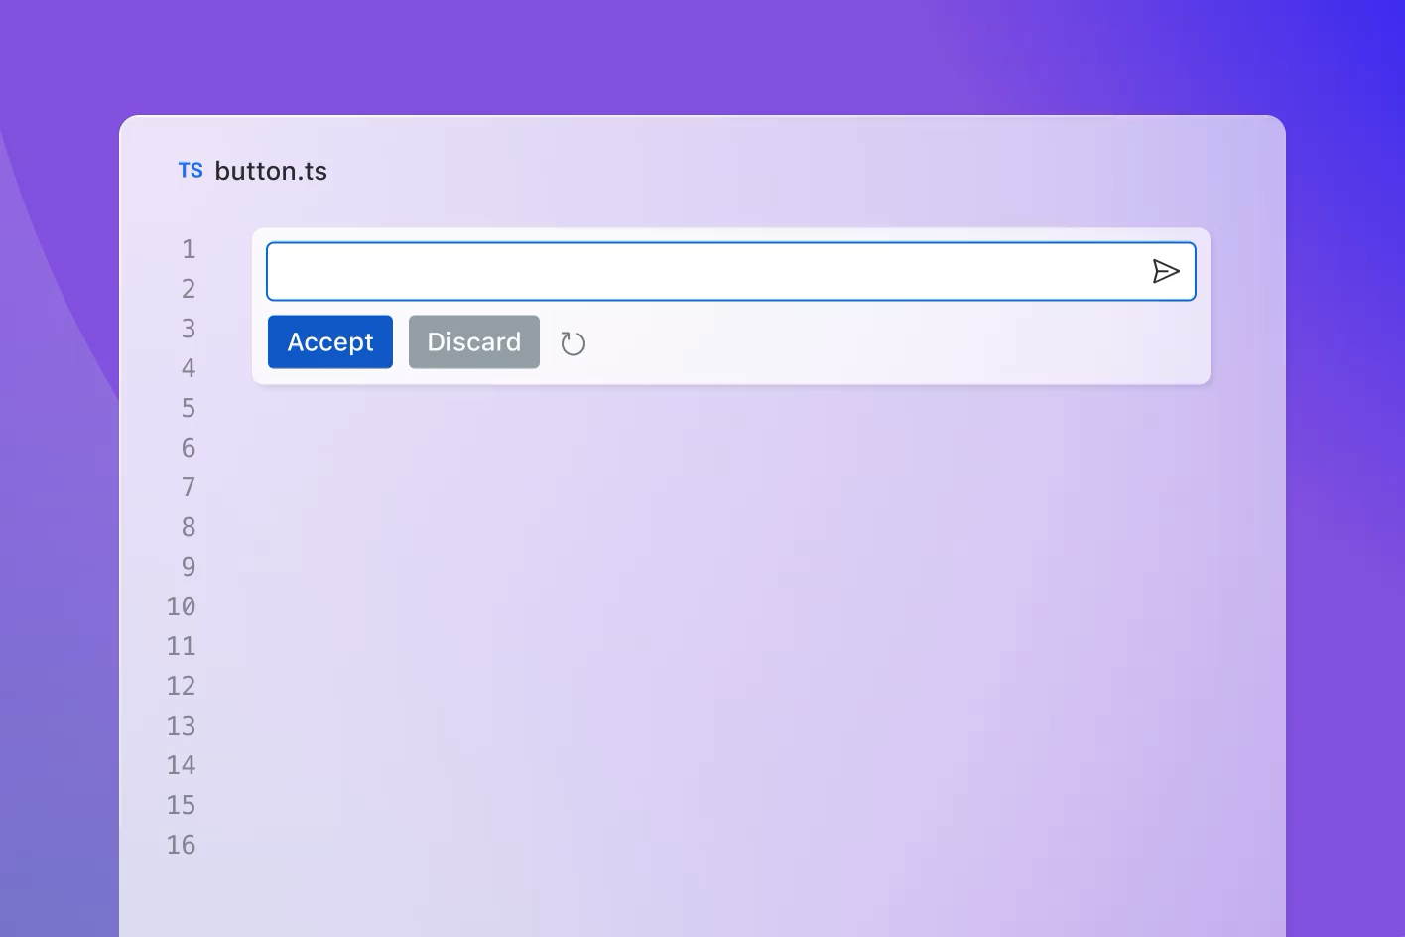

GitHub Copilot
Seu AI pair programmer
Sugestões de código em tempo real
Comentários para códigos
Next edit suggestions
Modelo gpt4o-copilot aprimorado
GitHub Copilot Chat & Edits
Inline chat commands
Agent mode
Notes:
So really github copilot together with VS code are your pair programmers they're enabling you to create and bring your ideas to life faster than ever Now while today we're going to be talking about the Visual Studio Code integration you know the GitHub copilot kind of works anywhere that you develop or your team develops including on github.com Visual Studio, xcode, jetbrains ides, neovim, and even on Azure. and the single subscription works with them all

Slide 16



















a nova central de comando...|
Agentic layer
Crie
Colabore
Opere
Notes:
For me, I spend most my day working not by myself, but with GitHub Copilot. I bounce off ideas, ask questions, and work on code together.
In fact, I ideate, design, build, deploy and maintain everything with GitHub Copilot. It really is my command center regardless of what I am doing and VS code is the glue that bring it all together.

Slide 17







Os desenvolvedores gastam apenas uma fração do seu tempo escrevendo novos códigos
Deploying /
Publicações
Design
Codificação
Arquitetura
14%
Pesquisa
Planejamento
Testes
Refatoração
Documentação
Migrações
Resolução de Bugs
Notes:
Now I just want to write code, but actually mode developers spend a fraction of their time coding, in fact it is about 14%
To me this is all about reducing TOIL. Every ones hates something in this circle, that is taking away from actually coding.

Slide 18


O GitHub Copilot pode ajudar você com tudo
Deploying / Publicações
Design
Codificação
Arquitetura
Pesquisa
Planejamento
Testes
Refatoração
Documentação
Migrações
Resolução de Bugs
Notes:
But GitHub Copilot can help with that.
So hopefully you grow the part of the chart that YOU love. For me I love coding and designing, and now I get to do more that that then ever.

Slide 19
Exemplo prático (Demo)
VS Code + Copilot
Notes:
OK with that out of the way let's just get into it and take a look at all this in action

Slide 20
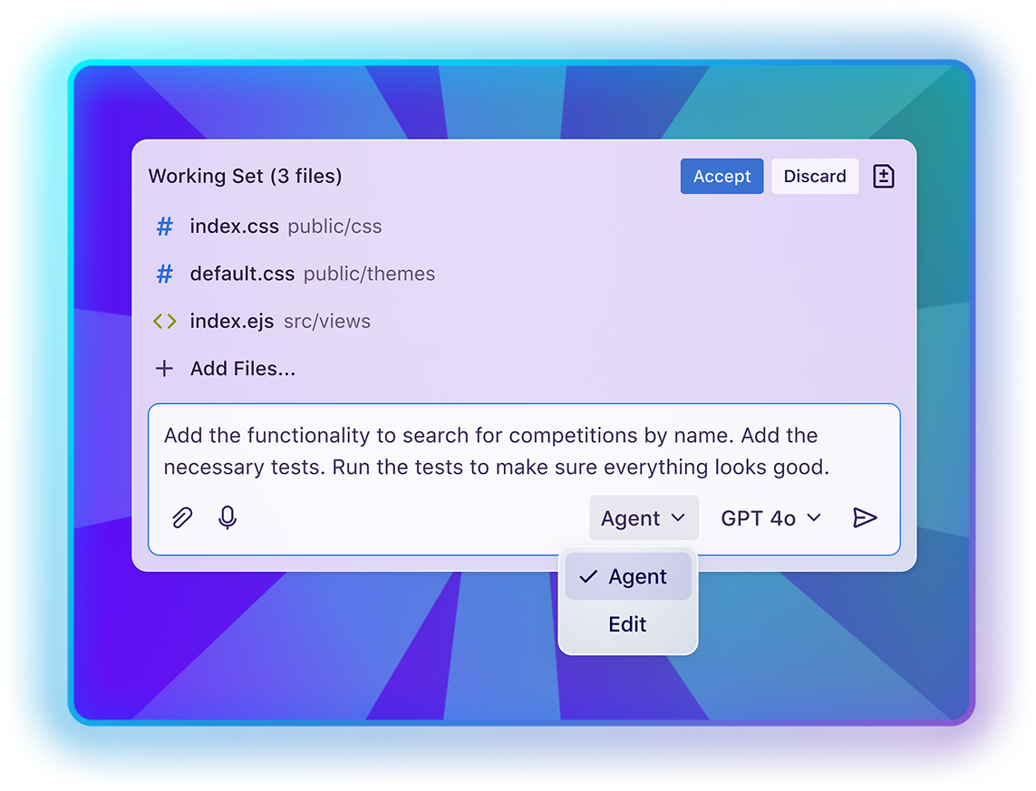
GitHub Copilot Agent mode
Agora disponível no Visual Studio, Visual Studio Code, JetBrains IDEs, Eclipse e Xcode
https://aka.ms/copilot-free
Notes:
so let's recap and take a look at Even more AI features in VS code
Agent mode has been available in VS Code for a a while.
And agent mode is also available in out for JetBrains IDEs, Eclipse, Visual Studio, and Xcode.
it truly transforms how you work by being able to work across your entire code base and it puts you in control with advanced customizations and access to several models. This pairs nicely with the main ask mode which enables you to just have conversations and get in-depth insight into your project with even more models that are made for deep thinking

Slide 21
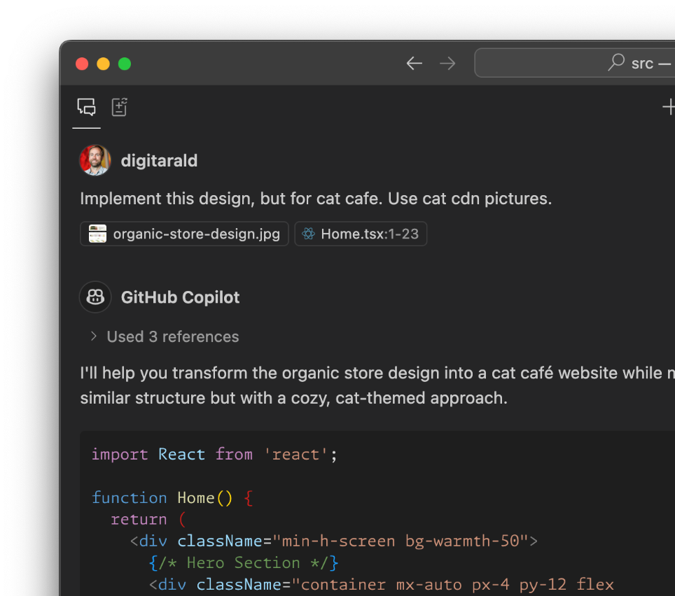

Multi-Model Choice
Últimos Modelos
Use o melhor modelo para sua tarefa e projeto com suporte para os últimos modelos da OpenAI, Anthropic e Gemini, incluindo GPT 5, Gemini 2.5 Pro e Claude Sonnet 4.
Melhore suas interações com o GitHub Copilot tirando proveito de múltiplos modelos.
Notes:
I have been mentioning models, and there there are tons of models available not only in agent mode but also in ask mode as well these models are available across VS code but also on github.com things for example like GPT 5 mini have unlimited requests and newer models like GTP 5, Gemini 2.5 pro and Claude sonnet 4 are available directly inside of VS code really leveling up how you work with agent mode

Slide 22
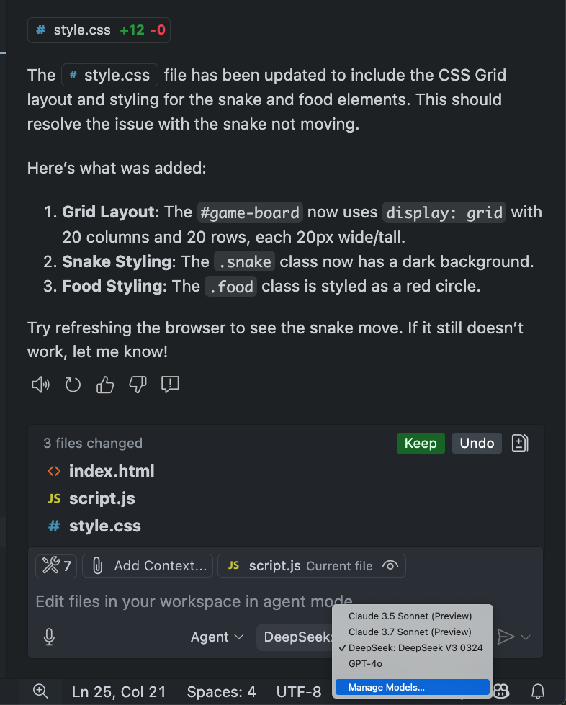
Multi-Model Choice
Utilize seu próprio modelo & key
Conecte-se a provedores de LLM customizados e use o modelo que melhor funciona para você.
Anthropic, Azure OpenAI (incluindo datacenters governamentais), Google Vertex, Ollama, OpenAI, OpenRouter
Public Preview – Copilot Free & Pro apenas
Notes:
A super powerful feature in addition to having built-in models is the ability to bring your own key so if you're using services like Google, open AI, Azure, open router, or anthropic you can just add your keys directly and select different models that are available based on your subscription to those specific services.

Slide 23

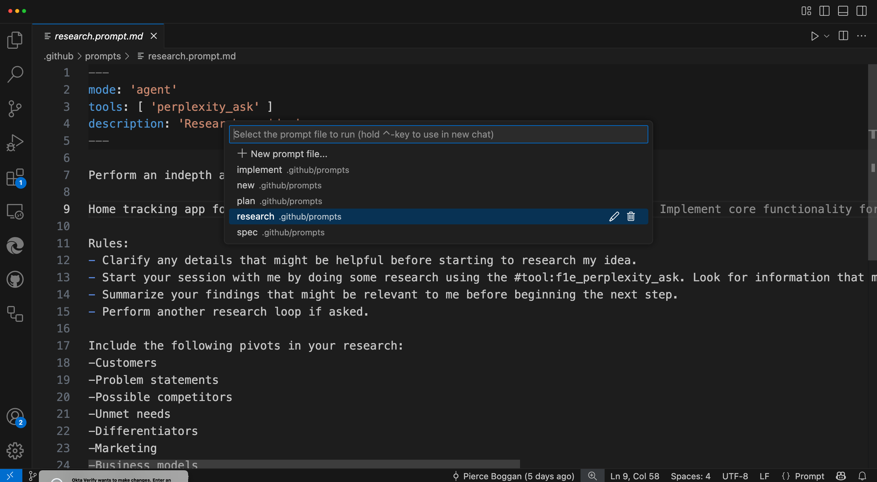
Team Customization
Personalized code and workflows
Crie workflows repetíveis e com tecnologia de IA para sua equipe, com arquivos de prompt que descrevem seus próprios prompts, ferramentas e modelos.
Escale o conhecimento do domínio de membros sêniores do time com custom instructions.
Crie custom modes que encapsulam diferentes workflows, como planejamento, debugging, etc.
Descubra os recursos de comunidade no repositório Awesome Copilot.
Notes:
we talk a little bit about customization not only are you able to create reusable repeatable AI flows with prompt files but you can completely transform how the coding agents are working on your code base with custom instructions. These custom instructions give them insight not only into your project structure but also your best practices of how you like code created and structured in your project. and there's new things like custom modes that enable you to create custom chat and agent integrations such as planning mode or debugging mode that help guide the agent to how you want to interact with it.
To get you started with these customizations, check out the Awesome Copilot repo, https://aka.ms/awesome-github-copilot, which has over 200 community contributed customizations to cover all sorts of scenarios – and contribute your own!

Slide 24
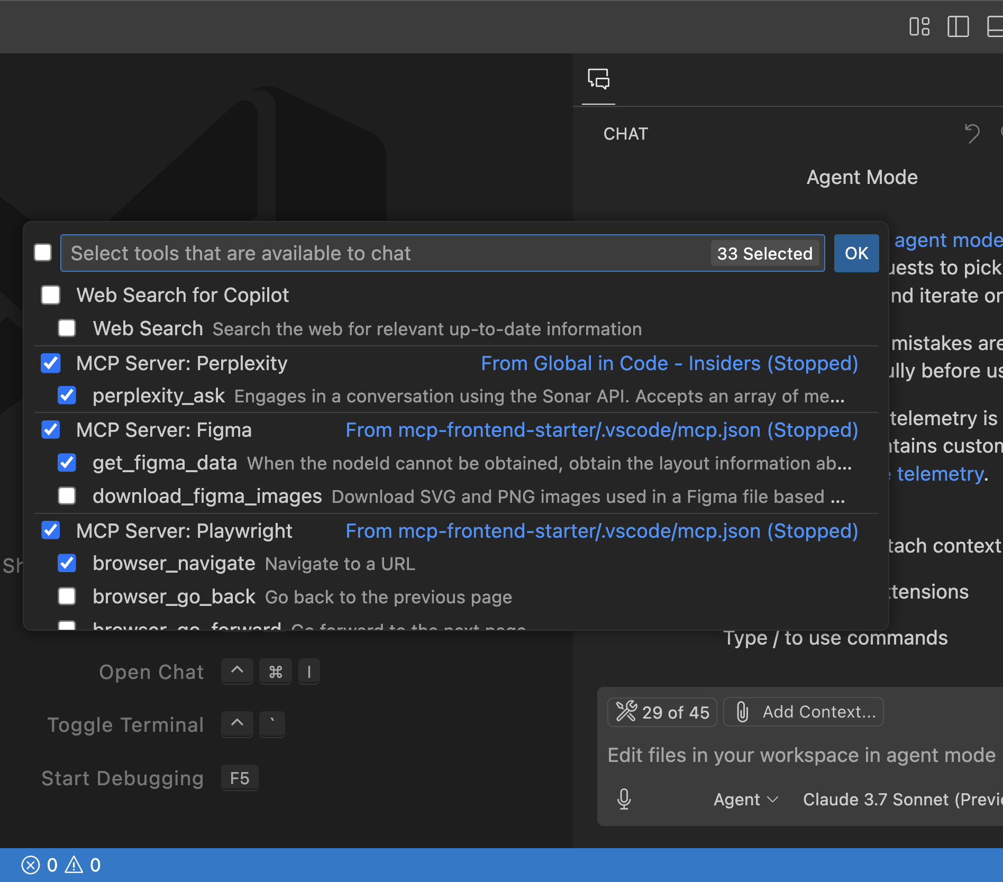
MCP Extensibility
Estenda o agent mode com Model Context Protocol (MCP)
Personalize o agent mode à sua maneira, adicionando ferramentas disponibilizadas por MCP Servers de soluções como Figma, GitHub ou Perplexity.
O VS Code é o único editor a suportar a especificação completa do MCP, incluindo OAuth, prompts, sampling e recursos.
Notes:
Extensibility is a huge part of working with agents and model context protocol is the standardization way of enabling AI applications to provide additional context and tools available to the alms. visual studio code has the entire MCP specification integrated like we saw including oauth prompts sampling resources and of course tools that enable you to not only query but also create on your behalf period

Slide 25
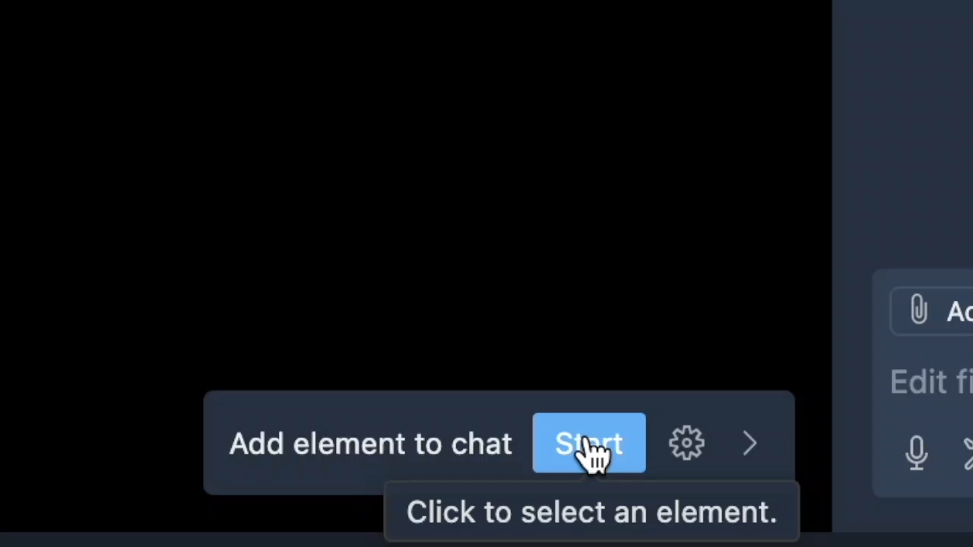
Browser Context
Visual web vibing
Notes:
Now with the built in browser you can not only get a live view of your running application but you can also select elements that you want to work on and directly communicate with the chat and agent to give it additional context

Slide 26
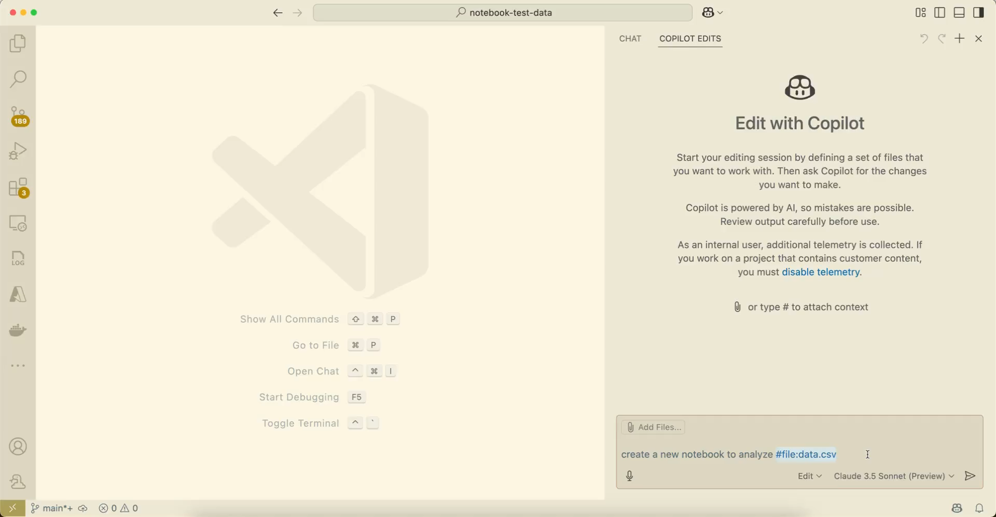
Data Science & AI Engineering
Copilot-powered Data Science
Notes:
and a really cool part here is that when you're working with the agent it's not just for code it can be for JSON files or markdown files or if you're doing data science and AI engineering work with jupiter notebooks it's available right there as well

Slide 27
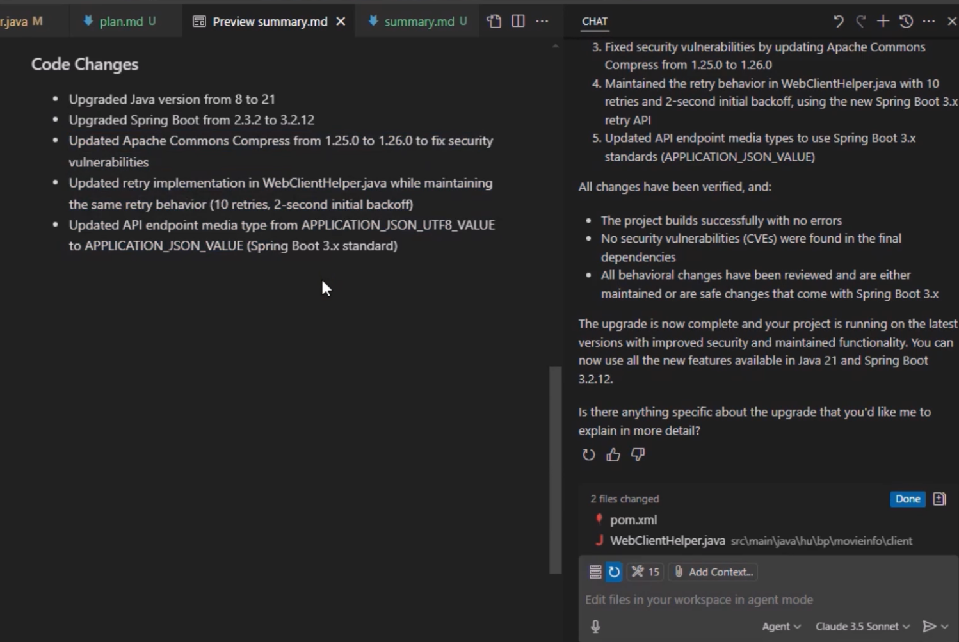
Java & .NET Upgrade (Preview)
Agents especializados para reduzir o trabalho do desenvolvedor
Membros expert em um time para resolver problemas específicos e reduzir o trabalho de engenharia.
Facilite updates com os agents para .NET e Java.
Notes:
and there are specialized agents that work inside of agent mode such as the Java and .net upgrade assistants that enable you to get your applications upgraded to the latest versions in no time at all

Slide 28
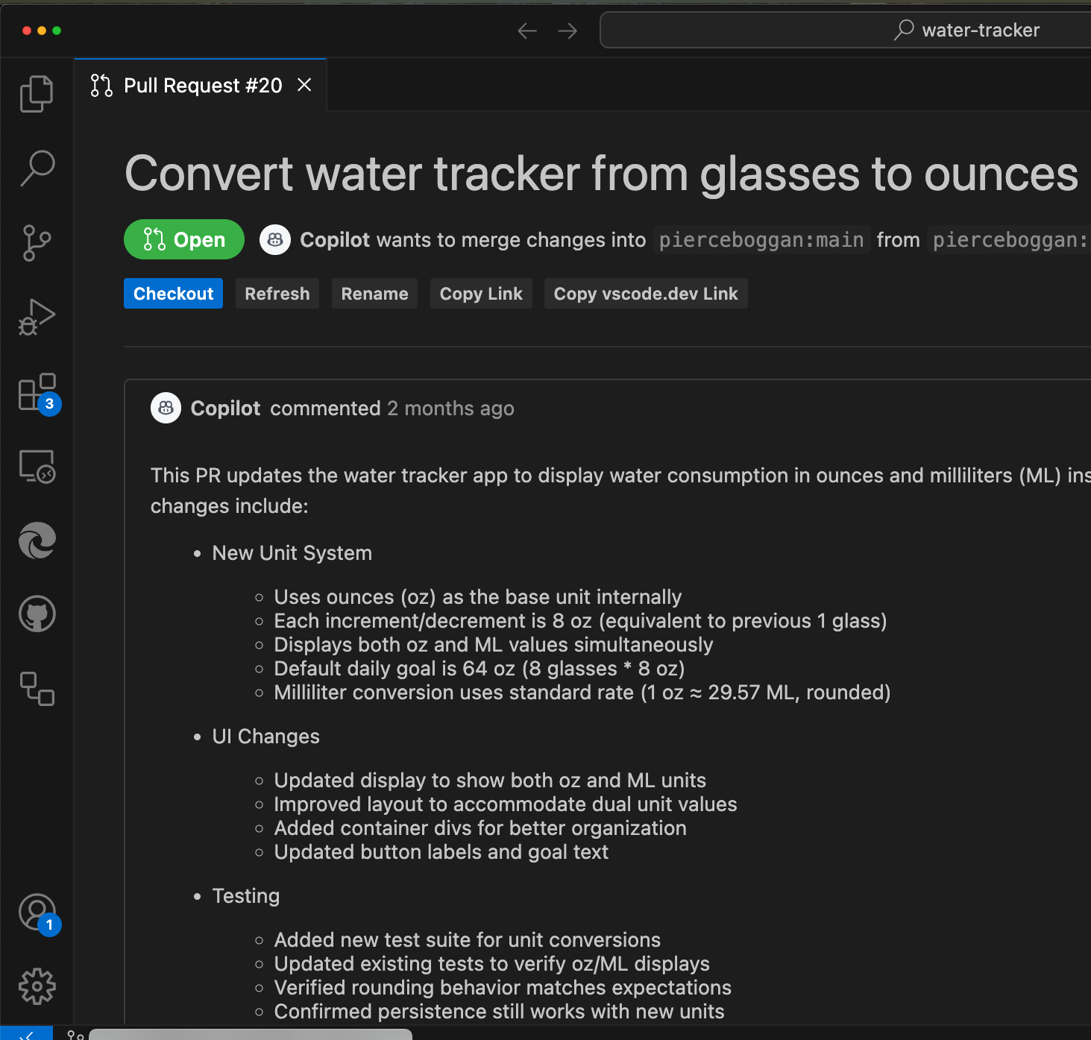
VS Code & Coding Agent (Preview)
Delegue tarefas para agents assíncronos
Os desenvolvedores podem conseguir ainda mais com agend mode delegando tarefas ao coding agent no VS Code.
Um coding agent trabalha como qualquer outro membro de um time: criando issues e submetendo PRs.
Tire proveito da integração com a plataforma GitHub em IDEs que Desenvolvedores adoram.
Notes:
and finally I want to point out that it's not just about coding directly in the editor it is how we use agents everywhere to achieve even more with the GitHub coding agent that is available on github.com you can easily hand off tasks that come to mind either on github.com or directly inside of VS code that's a wonderful way of collaborating with AI agents in your workflow

Slide 29
Notes:
and that is a complete overview of not only in Visual Studio code but also how does become the open source AI code editor for developers around the world

Slide 30
Obrigado!

Slide 31
Próximos passos
Download do VS Code: aka.ms/vscode-dev-days/get-vscode
Obtenha o GitHub Copilot Free: aka.ms/vscode-dev-days/get-copilot
Inicie o treinamento: aka.ms/vscode-dev-days/training

Slide 32

Por favor deixe seu feedback para a Microsoft.
Pesquisa ao final do evento
Notes:
Answers to these questions will go directly to Microsoft. No personal information is included.
This is a short survey, it will take less than 5 minutes to complete.

